Slide 1
Ransomware on the Mainframe Checkmate!
Chad Rikansrud

Slide 2
About me
Speaker at conferences
DEF CON, Derbycon, SHARE, RSA 2017, others
Mainframe security consultant
Reverse engineering, networking, forensics, development
Mainframe (z/OS) researcher
Doer of other stuff that probably isn’t interesting

Slide 3
What is ransomware?
Ransomware comprised of three major parts:
Infection vector (phishing, web drive by, SE, other)
Payload - generate key, enumerates and encrypts files
Command and Control (optional)
Communicates with victims
Stores keys
Other items as required (e.g. customer service)

Slide 4
Why are we here?
Was asked this question by some C-Levels:
“Do you think a mainframe could ever be infected by ransomware?”
Me – after about 17.3 seconds of thought:
“Yes. And it would work really well!”
Them:
”You can’t just open an email on a mainframe.”
Me – after shaking head:
“Right. But there’s still at least 3-4 ways I can imagine this working.”
“This is a misconception, other ways of introduction of malware.”

Slide 5
Percent of Systems Susceptible to Malware
To clarify this question, I made this handy chart:

Slide 6
About this presentation
Did not build a fully working copy of ransomware for the mainframe
Liberties were taken for security’s sake
But, if I can do it ....
This can be done
Do not rely on the obscurity of a system as a measure of prevention
Just another computer

Slide 7
So, why would it “work really well?”
Mainframe designed for batch workloads
Superfast I/O to disk + massive caching
Centralized catalog structure makes finding files a breeze
Most of all
BLISTERINGLY FAST HARDWARE ENCRYPTION

Slide 8
Ok, so how would this work?
Here is one idea:
System administrator is infected by malicious email / webpage
Malware deploys stage1 – keylogging & network sniffing
Captures tn3270 traffic, records hosts / ports
Captures User IDs / passwords relative to them
Malware deploys stage2 – upload, compile & run code
Use tn3270 host / port to upload code (using creds captured)
Multiple upload protocols (FTP, NJE, tn3270, SSH)
Victim system compiles & runs code

Slide 9
DEMOS

Slide 10
Ransomware Process
Infection
Encrypt
Demand
Recon
Payload

Slide 11
Infection
Infection
Encrypt
Demand
Recon
Payload

Slide 12
Drive-by Infection (one example)
MITM
Privileged Position
HTTP
Poor Controls
YOU
Browse

Slide 13
Other types
Malicious attachment
URL Redirect to similar looking site
Image processor
Plug-in vulnerability (Flash anyone?)
Myriads more. Some require interaction, some do not

Slide 14
Reconnaissance
Infection
Encrypt
Demand
Recon
Payload

Slide 15
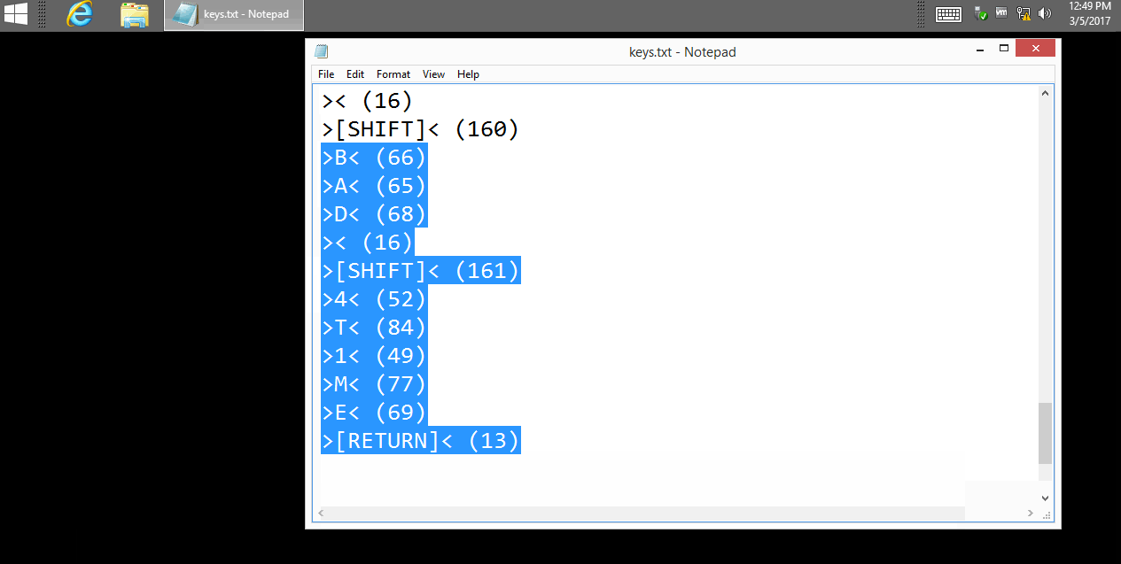
Key Logger

Slide 16
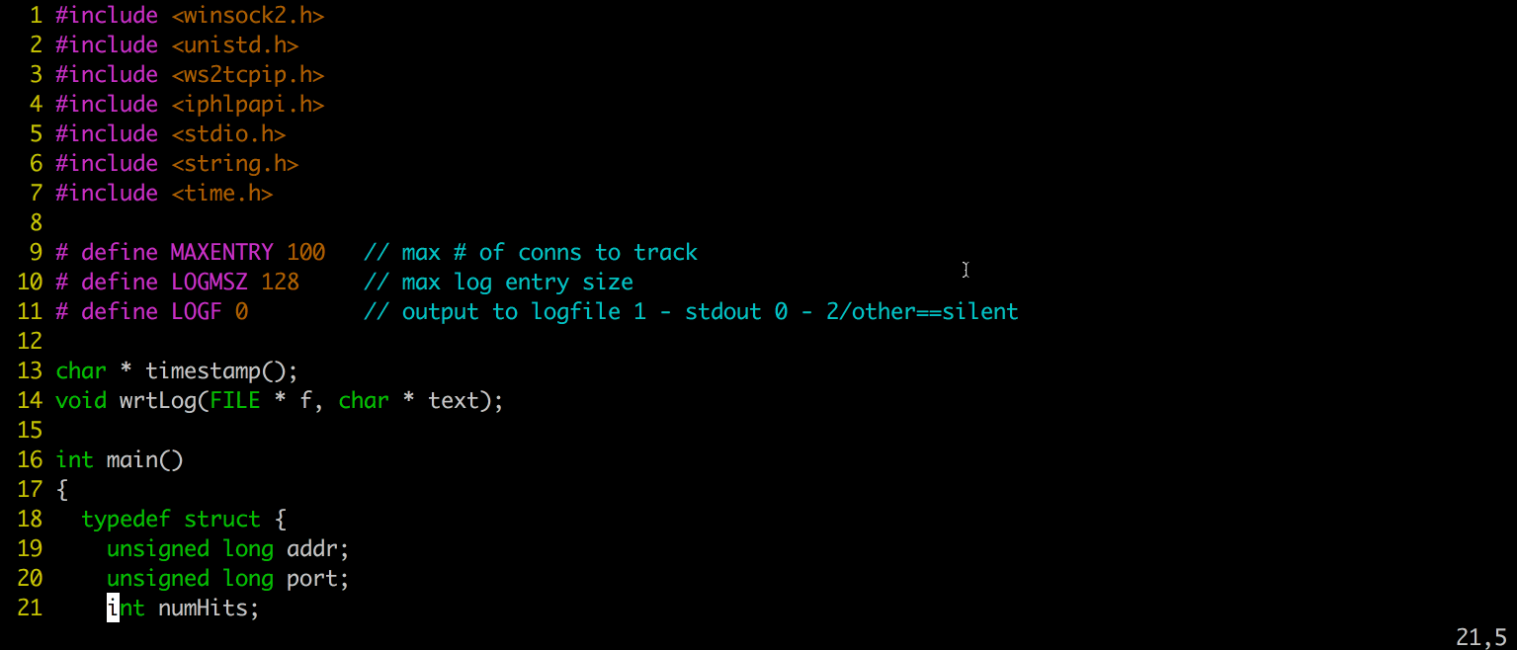
Connection Getter

Slide 17
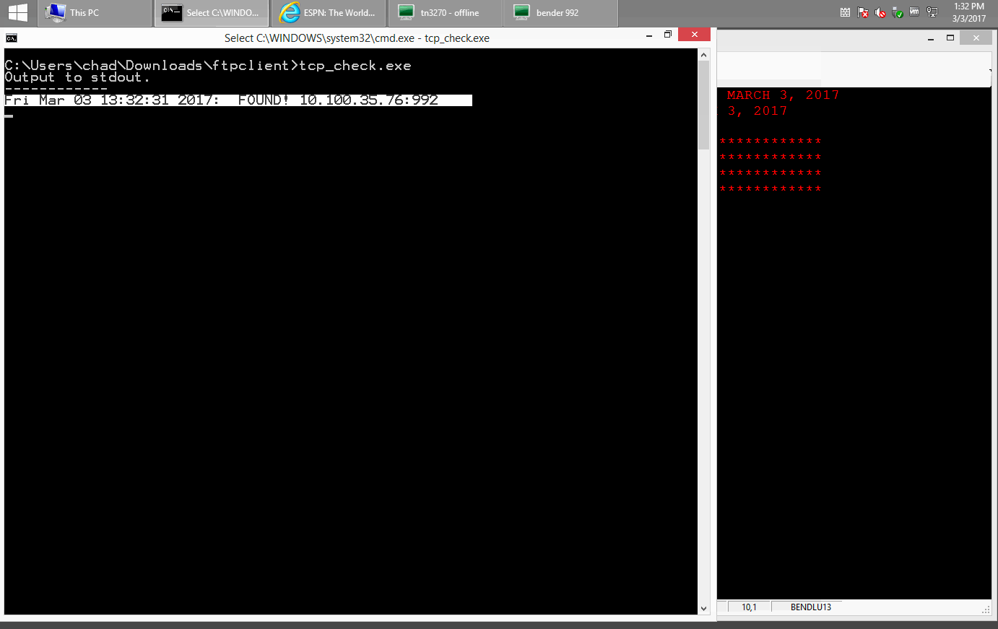
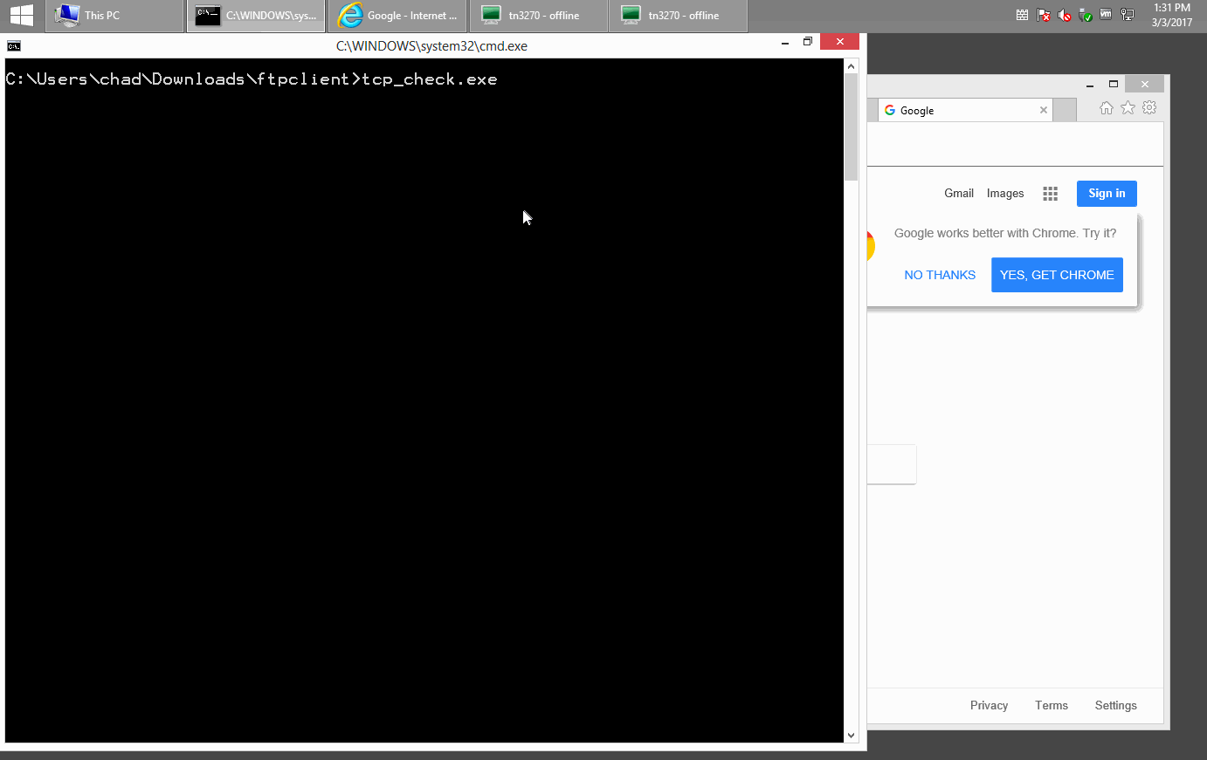

Slide 18
Deliver Payload & Enumerate Files
Infection
Encrypt
Demand
Recon
Payload

Slide 19
Payload Uploader
For this example, wrote a simple FTP Client in C
Hard-coded commands to upload malicious binary
Uses JES/FTP commands to execute binary
Checks for completion and cleans up
Works on Win/Mac/Linux
Uses input from key logger & connection getter

Slide 20
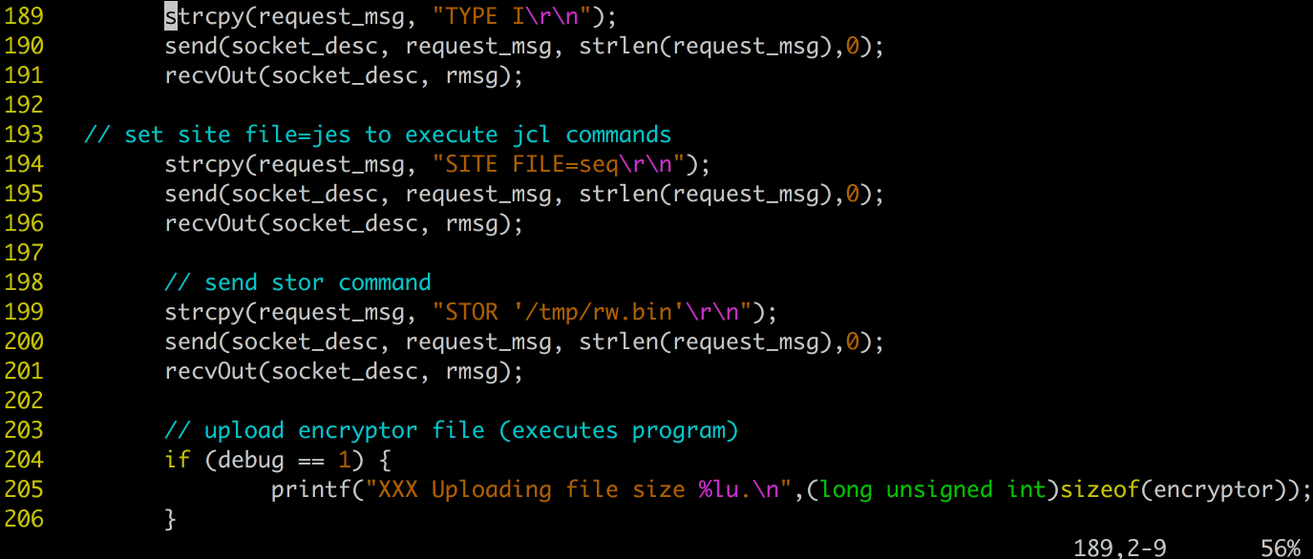
Payload Uploader

Slide 21
Enumerate Datasets
Using program from CBTTAPE
Modified for our purposes
Pass Master Catalog – lists all datasets
Added RACROUTE function to test for write access
This would be the input to the encryption function

Slide 22
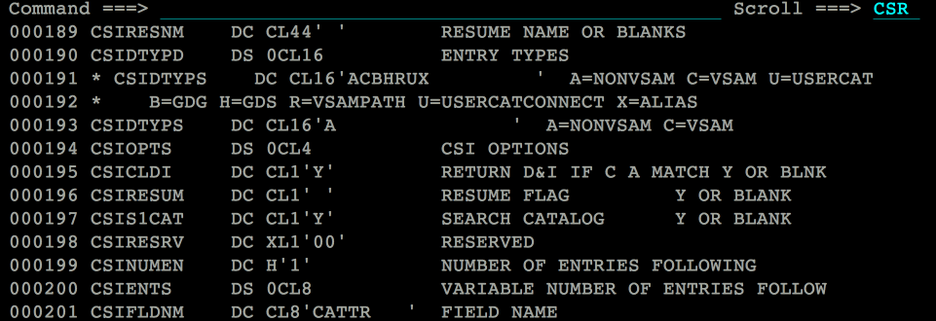
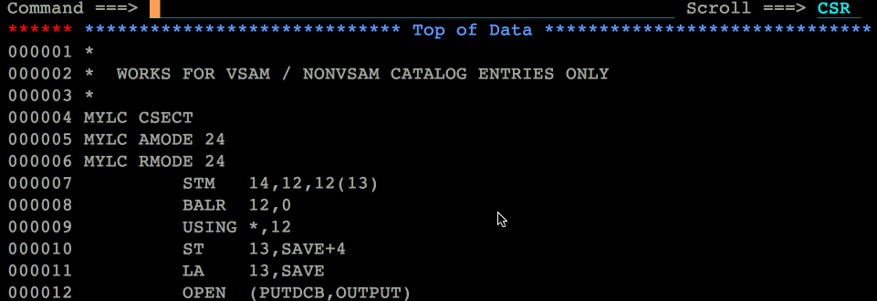
Enumerate Datasets

Slide 23
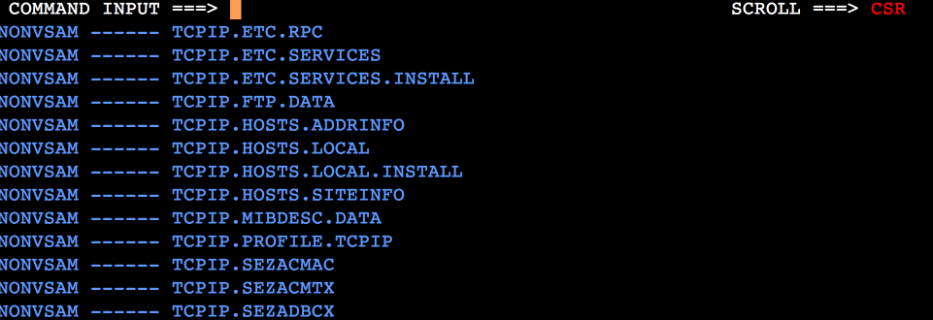
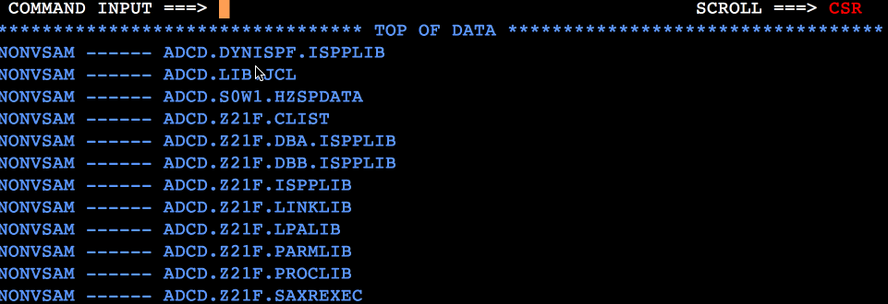
Enumerate Datasets

Slide 24
Encrypt Files
Infection
Encrypt
Demand
Recon
Payload

Slide 25
Encrypt Datasets - flow
Attacker has privileged position
Injects Javascript to a common website
User browses this site
Unknowingly runs malicious code in browser
Keylogger
GetConnection
UploadPayload
ExecutePayload

Slide 26
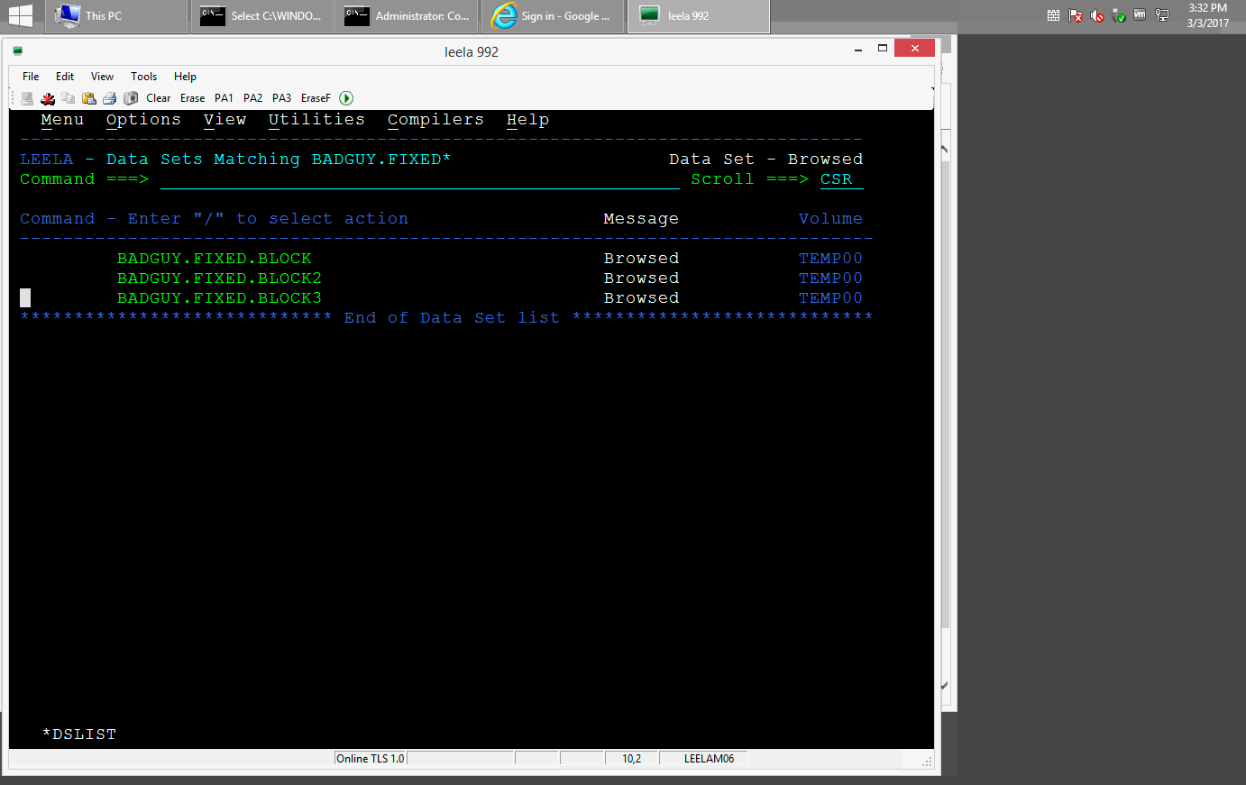
Encrypt Datasets

Slide 27
Finally .. Demand
Infection
Encrypt
Demand
Recon
Payload

Slide 28
Demands
Typically looking for Bitcoin
Mostly untraceable
Does your company have a policy?
What if there aren’t demands?
Just cause mayhem
Often files left behind with demands

Slide 29
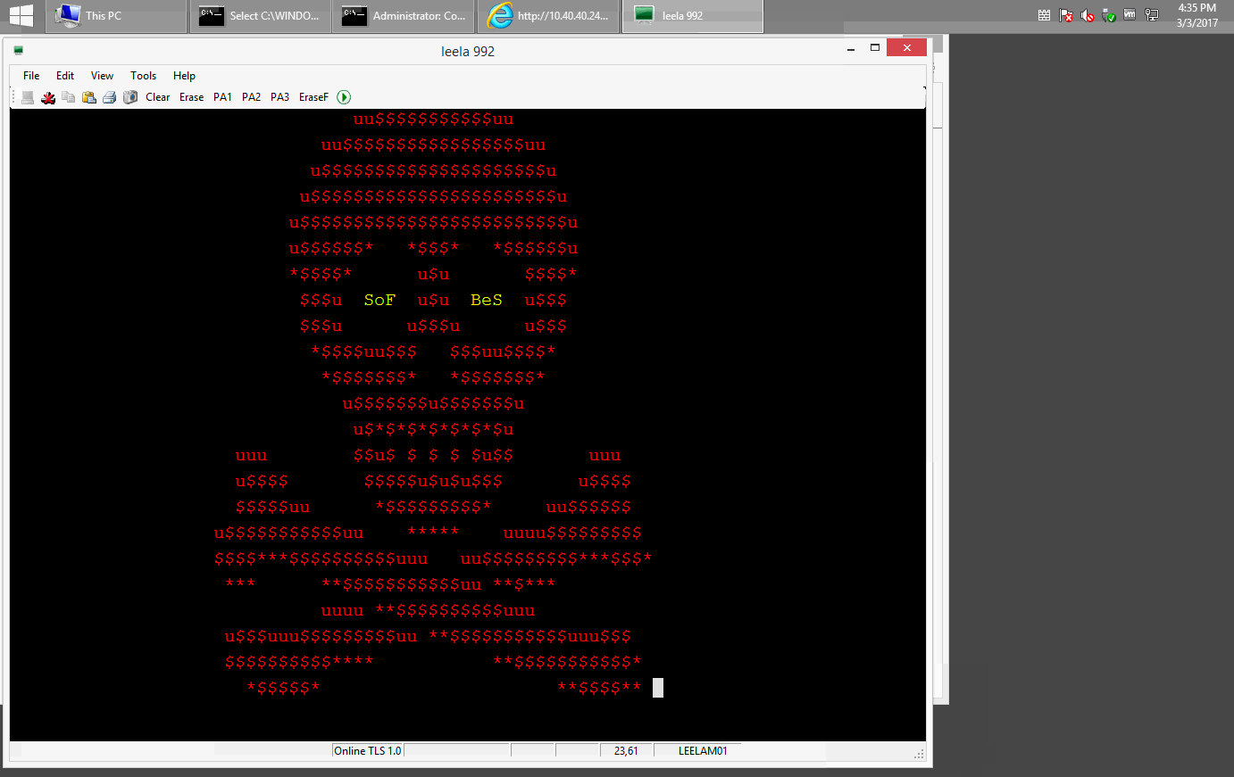
Demand Notification

Slide 30
Notify / Alerting
How will you know about the attack?
Do you realize something’s happened?
Likely jobs are crashing
But what if they don’t?
The ransom screen?
Once you figure it out, then what?

Slide 31
Incident response

Slide 32
Recovery
This is happening, but slowly
Need solutions similar to Time Machine (Think Mac)
Also needs intelligence for restarting jobs, etc.
Some solutions exist for this already
Any solution must preserve forensic evidence
Adjustable RPOs
Reasonable RTO (hours? minutes? seconds?)

Slide 33
What to do?
Multi-Factor Authentication
Egress Filtering!
Training
Endpoint Protection
Lock Down Crypto APIs
Logging, Monitoring, Integration, Correlation

Slide 34
What to do – part 2
Behavioral analysis
Start penetration testing
Partner with vendors
Think like an adversary
Phishing / social engineering

Slide 35
Thank You for Attending!

Slide 36
Appendix A
Encryption everywhere scenario

Slide 37
Phew, thank god that’s over
But ….
It gets worse. That was the hard way.
And it’s not just “big iron.”
What about:
“Encryption Everywhere”

Slide 38
Encryption everywhere ..
What is it?
All data files / disks are encrypted
Excellent for compliance / data protection
Excellent idea for data privacy – but ….
Focuses the risk now concentrated on key management
Doing the attacker’s work for them
Key management centralized
What would this attack look like?

Slide 39
Encryption Everywhere Takeover
Attacker compromises key management system
Attacker rotates/changes master keys (key encrypting keys)
Wait for x days, weeks – then delete original keys
What happens next?
Victim machine is eventually rebooted, needs to load keys
And then . . .

Slide 40
GAME OVER

